Slide 1


Understanding Carbon Markets & Potential for Pakistan

Slide 2
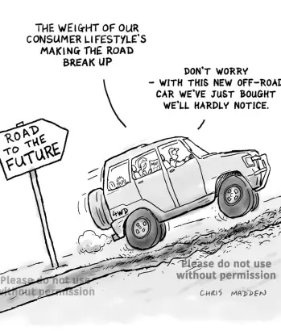
Why Markets for Climate Action?
Inextricable linkages between Economic growth and environmental cost to the society with the goal to limit the unsustainable practices
Integrating social cost of pollution in full through policies and regulations
Internalizing the environmental externalities leading to policies such as:
  Quantity Regulations
  Carbon Pricing mechanisms
Carbon Taxes, Cap and Trade Mechanisms

Slide 3
Paris Decarburization Target & Carbon Markets
50
Mitigation Targets and Financing
Business as Usual
40
Drastic emissions reductions required for keeping the global average temp in 1.5 ºC range (570 Gtons of GHG global budget)
GHG emissions to be cut by 50% from 2030 and reach to net-zero by 2050
Financing gaps to fund the required emissions reductions amounts to trillions - Not possible to be financed from public and/or concessional funding sources
-23 G ton from
current Level
30
20
10
0
Net Zero by 2050
2020
2030
2040
2050

Slide 4
Principle of Cap & Trade
A market-based approach used to control pollution by setting a ceiling on total pollutant emissions and providing an economic incentive for achieving emissions reductions
Participants are allowed to trade emissions reduction permits (aka allowances) in order to make profits from unused allowances or to meet requirements
Carbon Credit
A financial instrument equivalent to either:
(a) the right to emit 1 metric ton of CO2 (an allowance); or
(b) the reduction of 1 metric ton of CO2 (i.e an offset)
Carbon Offset
Offsetting involves reducing net carbon emissions by buying the rights to emissions reductions generated by GHG reduction projects
Offsets are project-based emissions reductions and may be used in voluntary or regulated markets

Slide 5
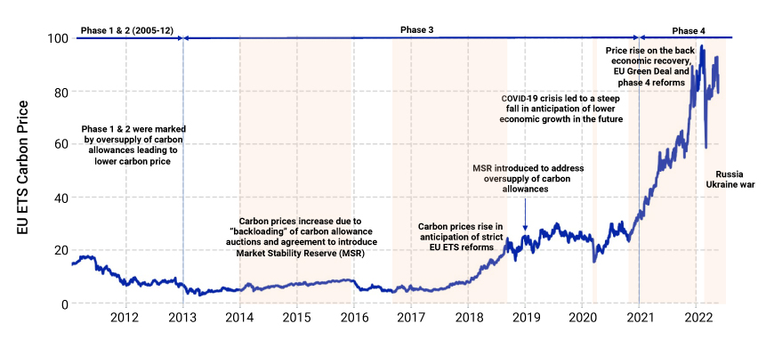
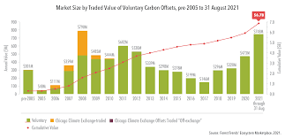

Introduction to Carbon Market
Compliance Vs Voluntary Market
Voluntary Carbon Market (VCM) is a decentralized market where private actors voluntarily buy and sell carbon credits that represent certified removals or reductions of GHGs
Compliance Carbon Markets (CCMs), are set by “cap-and-trade” regulations. Carbon emission certificates for domestic firms and sectors are issued by governmental organizations or international body (United Nations)C

Slide 6





Mechanism of Carbon Trading
$$$
$$$
$$$
Government implements carbon pricing mechanism or Emission Reduction Targets
With Carbon Pricing the cost of doing business and services increases incentivizing to shift the business to low emissions options
CO22
Renewable and low energy options becomes more competitive and cheaper and ultimately leads to low emissions

Slide 7
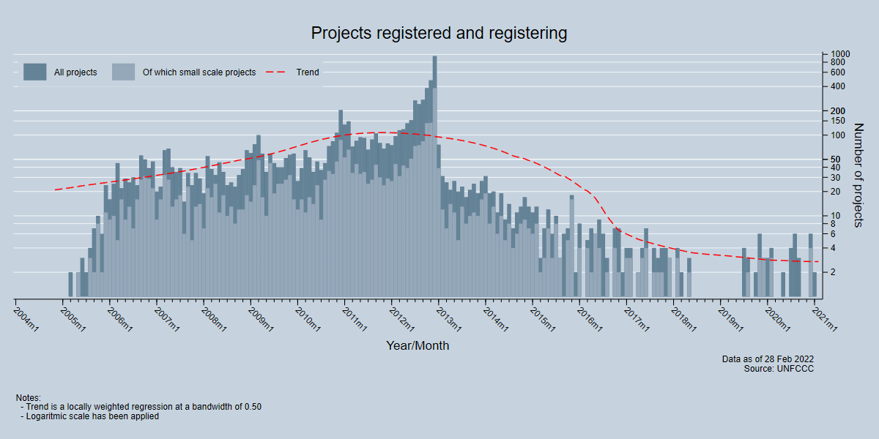
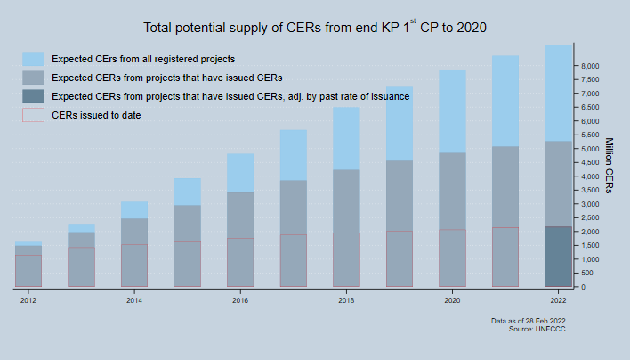
From Kyoto to Paris – Success and Lessons Learnt from CDM
  Articles 6, 12 and 17 of the Kyoto Protocol (1997) established the global carbon market
  CDM established the rules and methodologies for GHG emission reduction quantification, baselines and protocols for monitoring and verification
  Emissions trading systems facilitated the trading of carbon credits and established the billion dollar global carbon market
  Success of CDM shows the potential for Article 6 in contributing to the target of Paris Agreement

Slide 8
Voluntary & Compliance Market Specifications
Compliance Market
Voluntary Market
Objectives
Shifting to low emissions compliance
Emission reductions for voluntary commitments
Carbon Pricing
Market Based
Price Range:
Market Based
Price Range: 1$ to 60$
Product
Certified Emissions Reductions (CERs)
Voluntary Carbon Units VCUs/VERs

Slide 9
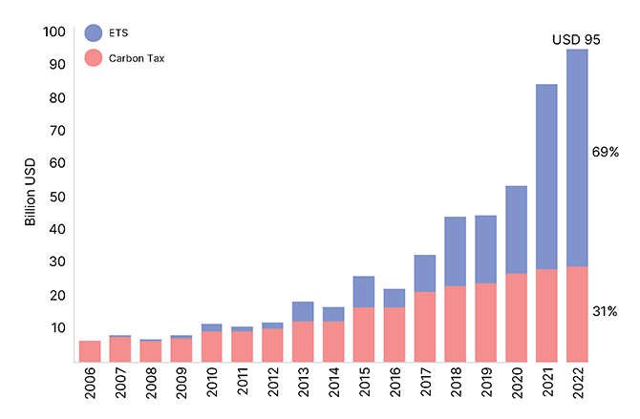
Growth of Carbon Markets in Numbers!
73 Initiatives
Carbon Prices Initiatives Implemented Globally
39 National Initiatives
Covered in these initiatives implemented
11.66 GtCO2e of Emissions
Representing 23% of global GHG emissions

Slide 10
Evolution and Comparative Size of National Carbon Markets
Mitigation Share of Carbon Markets
8,000
7.800
Plethora of national carbon markets emerging globally seeing the promise and potential for climate action
EUETS is the worlds first functional emissions trading system & 2nd largest system after China
Chinese Carbon Market is already largest of the world in terms of GHG emissions covered and set to grow exponentially
Pakistan can benefit by interlinking with Chinese carbon market
6.000
4.500
4,000
2,000
1.500
320
580
140
0
UK
S. Kores
California
EU ETS
China Current
China Projected

Slide 11
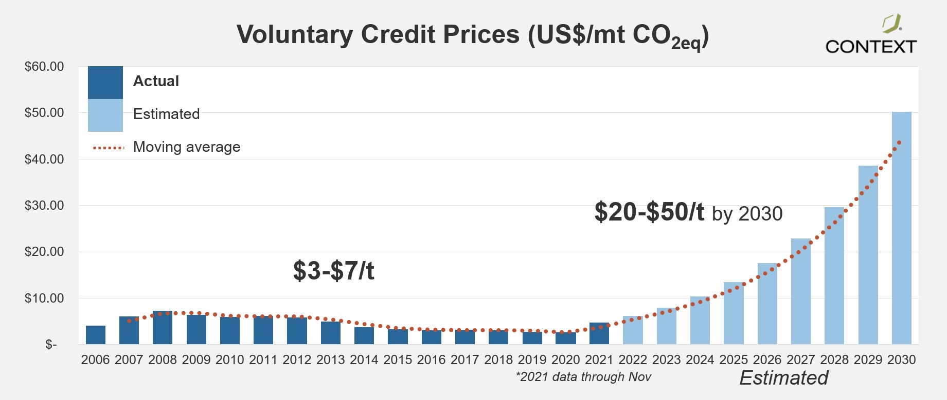
Carbon Credit Prices Trajectory
100
Carbon Prices as Economic Incentives
80
As of April 1, 2023, around 20 % of global greenhouse gas emissions are covered by a direct carbon price or some carbon pricing mechanism
Current carbon prices do not represent the actual price of climate induced impacts – Externalities
Carbon prices remain too low over a long period of time for inducing effective climate action
With the Paris Agreement becoming effective and demand for global carbon credits increasing the price for the carbon credits shown an increasing trend and likely to increase in future
60
40
20
2017
2018
2019
2020
2021
2022

Slide 12



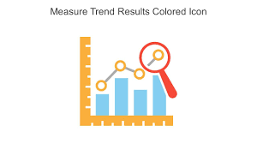

Advantages of Carbon Markets
Flexibility
Allows flexibility and choice for the industry to cut their emissions in a cost effective manner
Additionality
Regulatory requirements compels additional reduction and filters out business as usual scenario
Measurability
Methodological requirements ensures credibility and measurability through monitoring, reporting and verification
Innovation
Economic Incentives foster technological innovations for reductions

Slide 13
Typical Cycle of Carbon Reduction Project
01
02
03
04
Scoping
Designing/Validation
Implementation
MRV
Target Area Assessment
Technical and Financial Feasibility studies
Project boundary & GHG accounting
Ecosystem (ESG) services assessment
Secure funding
Select carbon assessment methodology and regime
Develop Project design documentation including baseline setting
Monitoring and Evaluation framework
Register project with suitable international carbon standard
Setup project management structure
Implement MRV system
Secure more funding for implementation
Implement MRV system as per the registered plan
Measure, report and verify Carbon
Trading of carbon and monetization
Sharing of revenues

Slide 14
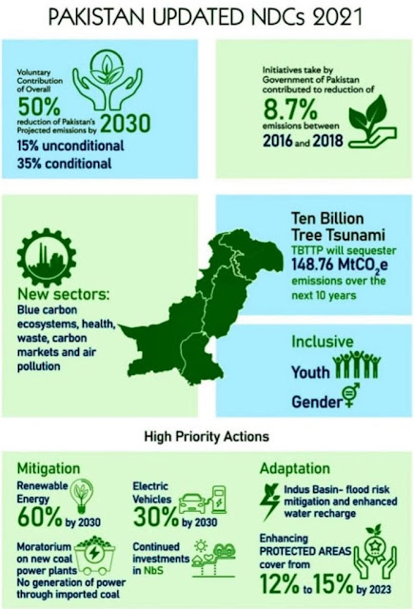
Carbon Market - Potential for Pakistan
  Pakistan has substantial potential for emission reductions in energy, transport, industry, agriculture and other sectors
  Marginal abatement cost in Pakistan considerably lower than many other parts of world
  Committed to reduce 50% of its overall projected emissions by 2030
  Substantial needs for Financing both for mitigation as well as adaptation purposes
  Article 6.4 can translate the financing through transaction of untapped emission reduction
  Pakistan needs to set-up institutional and procedural frameworks

Slide 15

Potential in Corporate Sector
  24 Companies voluntarily declared to become NetZero by 2030 or 2050
  Vibrant Sustainability objectives set by Corporate Sector where reducing carbon footprints is one essential goal
  Export oriented companies shall have to comply with a range of international standards – such as CBAM
  Energy Sector alone offers a substantial potential for emissions reduction – currently represents nearly 40% of Pakistan GHG emissions
  Carbon financing can provided the much needed financing for the corporate sector

Slide 16
NDRMF Role & Support
Supporting Carbon Markets in country part of NDRMF Strategic Framework and mid to long term Strategy
Assist and support Government Bodies for establishing policy and regulatory frameworks for integrating carbon markets as part of climate action program
Working with private sector and assisting in aligning their Sustainability and Carbon Emissions goals with international regulatory requirements
Develop guidance tools and instruments for different industries on technical aspects of Carbon Markets
Facilitate hands on training on Methodologies for Carbon Quantifications, develop projects and assist in Sale of Carbon Credits
And much more…..

Slide 17



Questions & Discussion
http://: www.ndrmf.pk
Follow NDRMF on:

